Slide 1

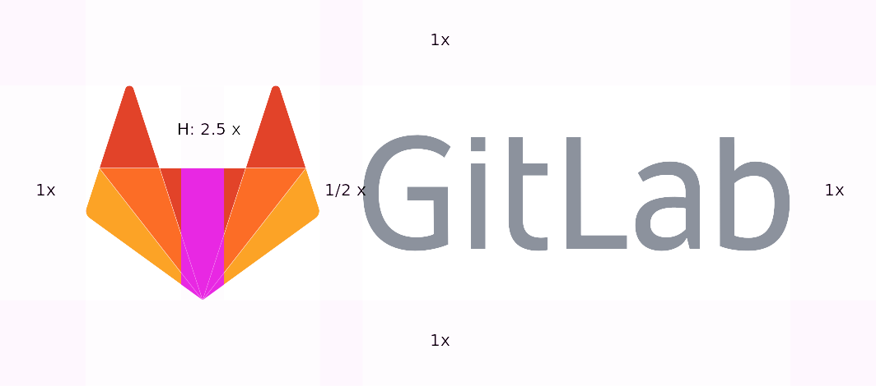
Postcard
Compare the past with the present
Usage
Select a photo, ideally with geolocation data
Configure an overlay containing the photo
Use the overlay to align with the subject in Camera app
Required Permissions
See Privacy Policy for explanation of permissions and
analytics
FILES AND MEDIA
LOCATION
DISPLAY OVER OTHER APPS
SELECT PHOTO
1234abcd/1.0.0-googleplay

Slide 2

Select Photo
Source
STORAGE FOLDER...
Google Photos
Library
Start...
End...
Category
Key
Tap to Configure Overlay
Approx distance (if geolocation data available)
Launch navigation App (if installed on device)
5m
25km

Slide 3
Configure Overlay
Window
Border & button colour
Width
Height
Photo
Transparency %
Edge Detection
Blur
Thresholds
Preview
. use header to move overlay
. pinch and zoom supported
DISPLAY OVERLAY

